Slide 1

BRINDAVAN INSTITUTE OF TECHNOLOGY AND SCIENCE(BITS-KNL)
(Affiliated to JNTUA,A.P)
NH-44, PEDDATEKUR, KURNOOL-518218
DEPARTMENT OF COMPUTER SCIENCE & ENGINEERING
A Project Review on
AI-POWERED ELDERLY CARE AND EMERGENCY ALERT SYSTEM USING IOT INTEGRATION
Presented by
TEAM NAME : BABES GOT BYTE’S
Team Member Names: Roll Numbers:
1. K.Raja Kumar (212N1A0551)
2. P.Tharun Kumar (212N1A0557)
3. S.Khaja Hussain (212N1A0569)
4. S.Sadiq (212N1A0575)
5. S.Naveed Ahmed (222N5A0504)
Project Guide:
Mr. K. Raju
Assistant professor of CSE department
Head of the Department:
Mr. S. Srihari Reddy
Assistant professor of CSE department

Slide 2
CONTENTS:
Introduction
Abstract
Objectives
Literature survey
Existing system
Proposed system
Software and hardware requirements
Project Architecture
System Design
1. Flow chart
2. UML Diagram
3. Dataflow Diagram
Modules
Sample Code
Screenshots
Future Scope
Conclusion
References

Slide 3
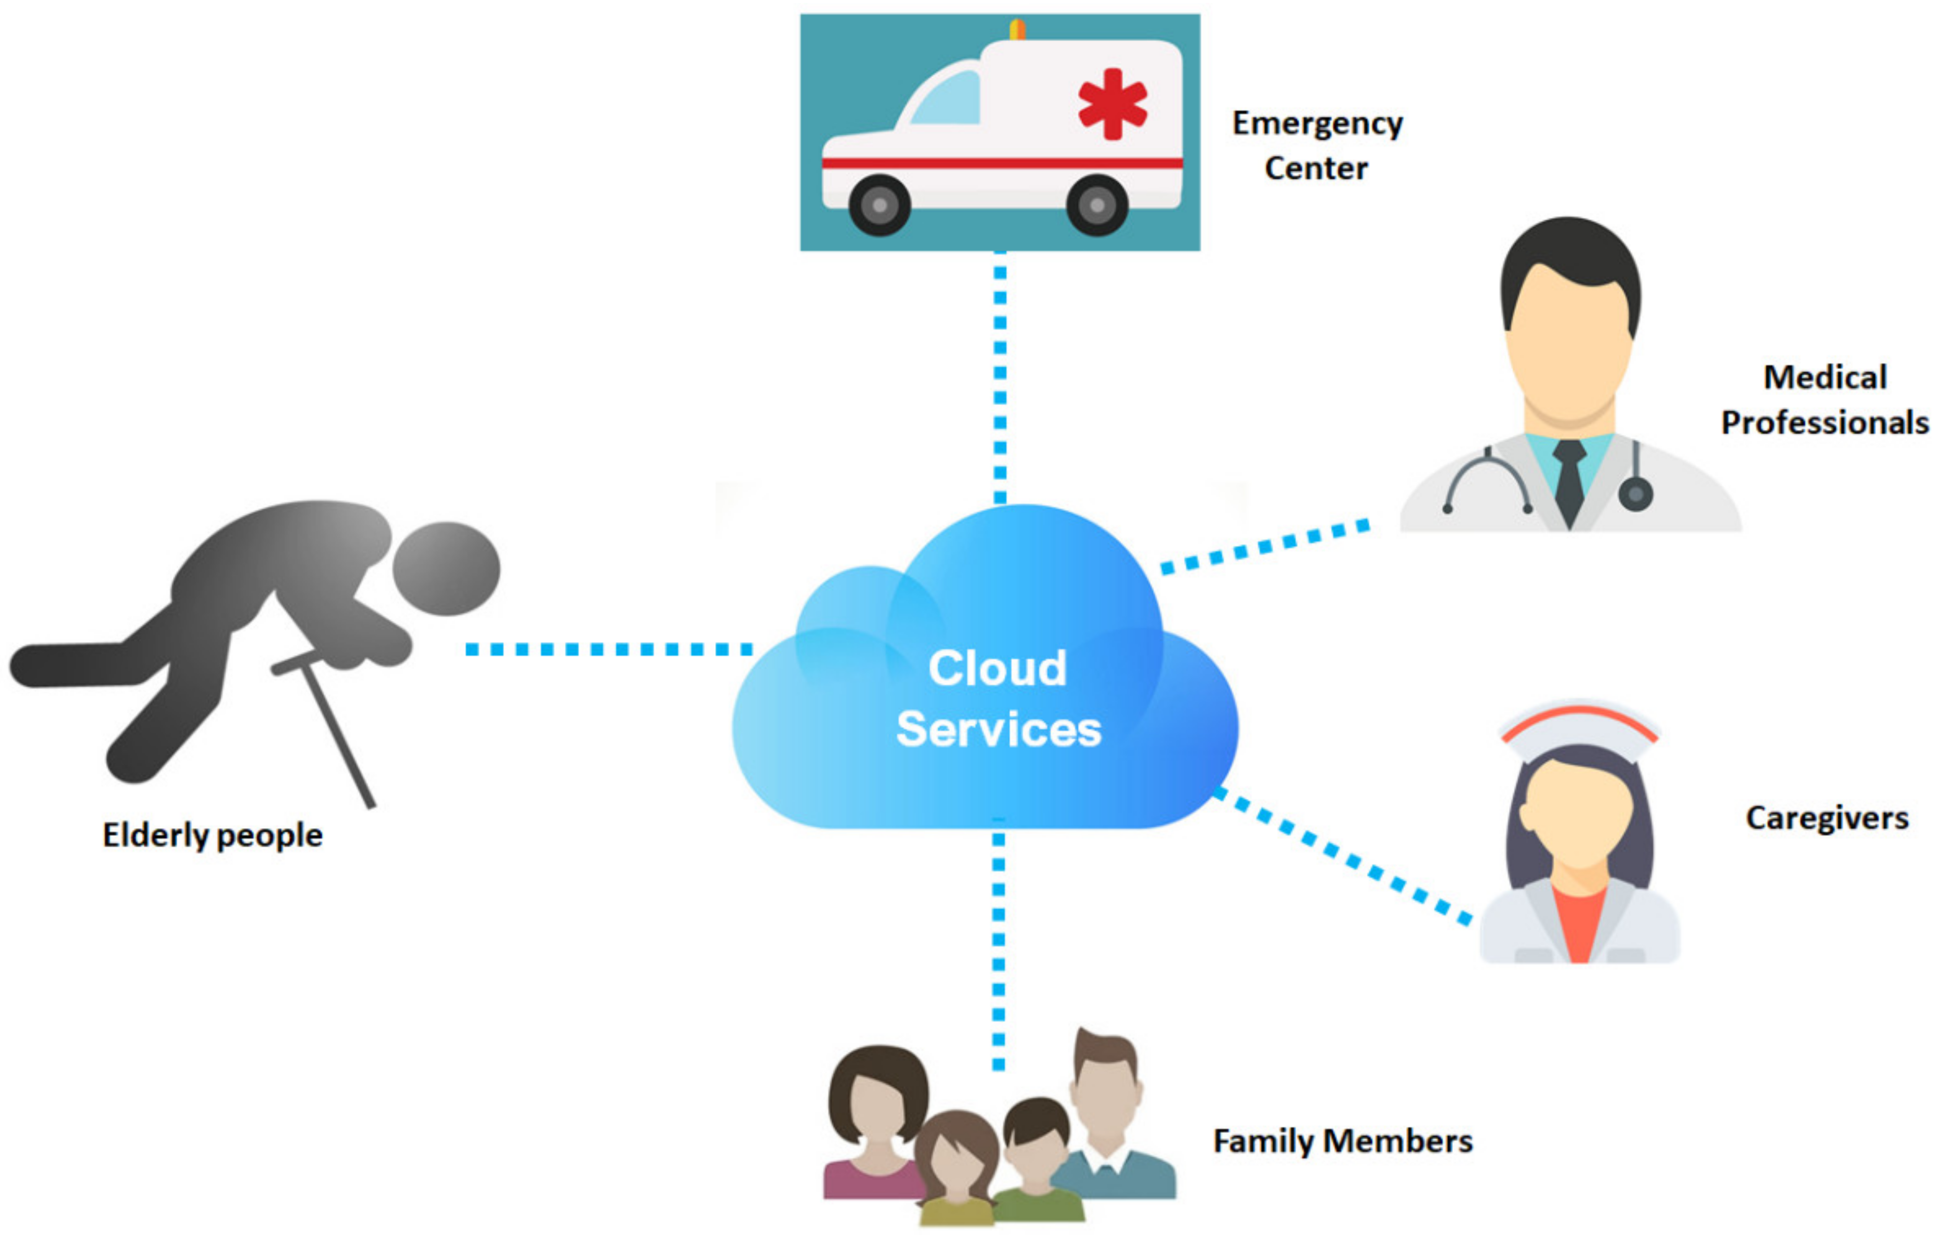
INTRODUCTION
In the past, the system can’t notify caretakers while in emergency situations or whenever in need which leads to lack of faster response and better care towards elderly people.
To overcome above problem we uses IoT technology with AI algorithm(regression,classification,k-means) to monitor vital health metrics such as oxygen saturation level, pulse rate, motion detection , Fluxual actions , temperature etc in the project.
The system can detect critical events and automatically notify caretakers enabling faster response and better care.
The system focuses on enhancing the quality of life for seniors by addressing their physical, emotional, and social needs.

Slide 4
By integrating caretakers and family members into a unified network can ensures timely support and fosters safe independent, dignified living environment for the elderly.
We use Frontend technology in this project for creating a web page such as Login page, Registration page using(HTML ,CSS, JAVASCRIPT).
We also use Backend technology(Python) in the project for the purpose backend operation .The continuously collecting data from the sensors and analyzes in the form of graphical structure using THINKSPEAK.
Blynk platform is used for directly notifies the caretakers about the patient requirements such as need(Water, Food, Medicine, Help etc.) as well as continuous fluxual health metrics showing through the dashboard.

Slide 5
ABSTRACT
An AI-powered elderly care and emergency alert system uses IoT technology with AI algorithm(regression,classification,k-means) to continuously monitor health parameters such as motion detection, pulse rate, blood oxygen levels, temperature level , fluxual actions by providing real-time data analysis and timely alerts to caretakers, thus enhancing the safety and quality of life for the elderly people.
The project uses various sensors, including IR sensor that detects the motion of sudden fall of patient and alerts caretakers or family members. Heart Rate sensor (pulse monitoring) that measures heart rate by detecting blood volume changes in arteries.
SPO₂ sensor that tracks blood oxygen saturation levels . Temperature Sensor that detects the body heat-rate of the elderly people
Additionally, Four Flux Sensors are used to notifies caretakers as per patient requirements(such as need Water, Food, Medicine, Help etc).
All these sensors integrated to WIFI Module(ESP-32) which takes data from sensors and communicates with other components as per requirement.

Slide 6
We use a Voice Recommendation in an AI-powered elderly care and emergency alert system using IoT integration, to caretakers to receive information about patient health conditions .
We use Frontend technology in this project for creating a web page such as Login page, Registration page using(HTML ,CSS, JAVASCRIPT).
We also use Backend technology(python) in the project for the backend operations .The continuously collected data from the sensors, analyses in the form of graphical structure using THINKSPEAK.
Blynk platform is used for directly notifies the caretakers about the patient requirements such as need(Water, Food, Medicine, Help etc.) as well as continuous fluxual health metrics through voice recommendation and alerts through mobile app with an buzzer sound .
Based on the data shown in thinkspeak we provides the health recommendation to caretakers to overcome the problem and provides the health metrices report of the patient.

Slide 7
OBJECTIVES
Enhance Safety and Security:
This project not only improves health outcomes, but also provides peace of mind for caretakers and family members by ensuring safety and security of elderly people.
Real-time Monitoring:
By using IoT devices like heart rate, oxygen levels, temperature and flux sensors are used to notifies caretakers as per patient requirements(such as need Water, Food, Medicine, Help etc ).
Improved Health Monitoring:
We integrate wearable devices to track health of elderly’s fall detection, pulse rate, oxygen saturation level in the blood and provide the health status of elderly people to their caretakers.
Enhance Communication:
Facilitates easy communication between elderly people and their caretakers or family members through Alerts using centralized platform for seamless data transmission and analysis.
User Friendly Interface through Voice recommendation:
This system is accessible through voice output, making it easy for caretakers to interact with technology without needing any advanced technical skills.

Slide 8
LITERATURE SURVEY
IoT in Elderly Care and Health Monitoring:
Reference: Hong, Y., Lee, J., & Kim, S. (2018). "IoT-based health monitoring system for elderly." Journal of Healthcare Engineering, 2018, 1-10. doi:10.1155/2018/7431285
Fall Detection Systems Using IoT and AI:
Reference: Joo, J., Kim, S., & Yoon, H. (2019). "AI-driven fall detection for elderly care systems." Journal of Medical Systems, 43(7), 179. doi:10.1007/s10916-019-1389-4
Voice Assistants in Elderly Care:
Reference: Chung, W., Lee, Y., & Kim, H. (2020). "Voice assistants for elderly individuals: A review of applications and technologies." Journal of Assistive Technologies, 14(3), 215-229. doi:10.1108/JAT-07-
2020-0017
https://youtu.be/plnA5EYrmD4?si=QV_15wg7SckXhbtn
https://youtu.be/MCg2QSEsLPE?si=tAtABglOf7RK_S-W

Slide 9
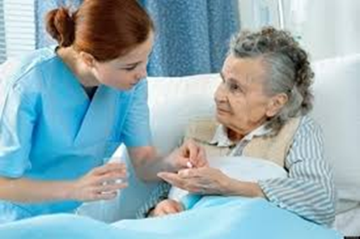
EXISTING SYSTEM
In the Existing System may lack the ability to alert the caretakers while they are not present near to the patient or elderly people.
The Existing System can’t notify caretakers while in emergency situations or whenever in need which leads to lack of faster response and better care towards elderly people .
Real-time Responsive
Personalization
Data Privacy Concerns
Cost and Accessibility

Slide 10
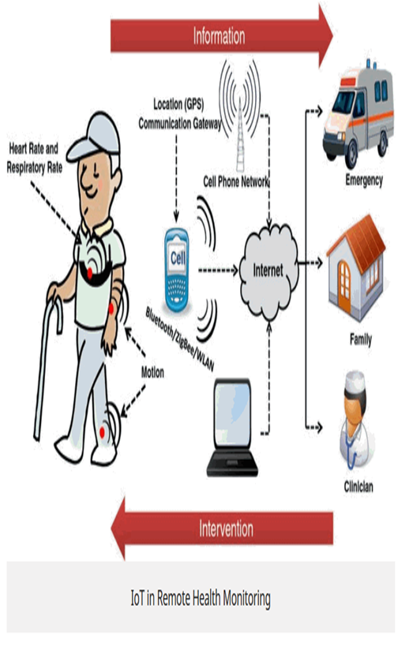
PROPOSED SYSTEM
1.User management:
By using Frontend technology in this project we create a web page such as Login page and Registration page by using(HTML,CSS, JAVASCRIPT).
If the patient is new clickon to registration page then fills the details of the patient if already registered login directly.
2. Emergency Alert:
The registered patient data stored in the cloud and the user can access data of the patient by login to the webpage.
Using THINKSPEAK platform the user can access the analyzed data which is collected from sensors that are integrated to WIFI Module(ESP-32).
According to analyzed and collected data an alert notifications sends to the caretakers using Blynk platform.
All these are done by using Backend technology in the project by (python).

Slide 11
3.Health Monitoring:
The project uses various sensors, including IR Sensor that detects the motion of sudden fall of patient and alerts caretakers or family members, Heart rate sensor (pulse monitoring) that measures heart rate by detecting blood volume changes in arteries.
spo2 sensor that tracks blood oxygen saturation levels. Temperature Sensor that detects the body heat-rate of the elderly people.
All these sensors integrated to WIFI-module(ESP-32) which takes data from sensors and communicates with other components as per requirement.
Additionally, four flux sensors are used to notifies caretakers as per patient requirements(such as need water, food, medicine, fresh air etc.)
4. Dashboard & Reporting:
We use an Voice recommendation in an AI-powered elderly care and emergency alert system using IoT integration, for caretakers to receive information about patient health conditions. Based on the data shown in thinkspeak.
According to health metrices data provides the health recommendation to caretakers to overcome the problem and provides the health metrices report of the patient.

Slide 12

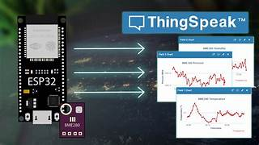

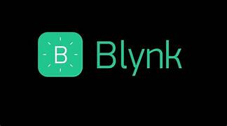
SOFTWARE AND HARDWARE REQUIREMENTS
Hardware Tools:
IOT Requirements:
Microcontroller(e.g. Esp32/Node MCU )
4-Flux Sensors
IR Sensor
Pulse monitoring Sensor (C101A3)
SPO₂ Sensor (Ds100a-1)
Temperature Sensor
Buzzer
Power Source (5v,3.3v)
System Requirements:
Hard disk(512GB or Above)
RAM(8GB or Above)
Processor(11th Gen Intel® Core™ i3 2.00GHz or Above)
Software Tools:
Arduino IDE(integrated development environment)
Thinkspeak Platform
Blynk Platform
Frontend-HTML,CSS,JAVASCRIPT
Backend-(PYTHON)
voice recommendation(pyttsx3)
Code Editor(VS Code)

Slide 13
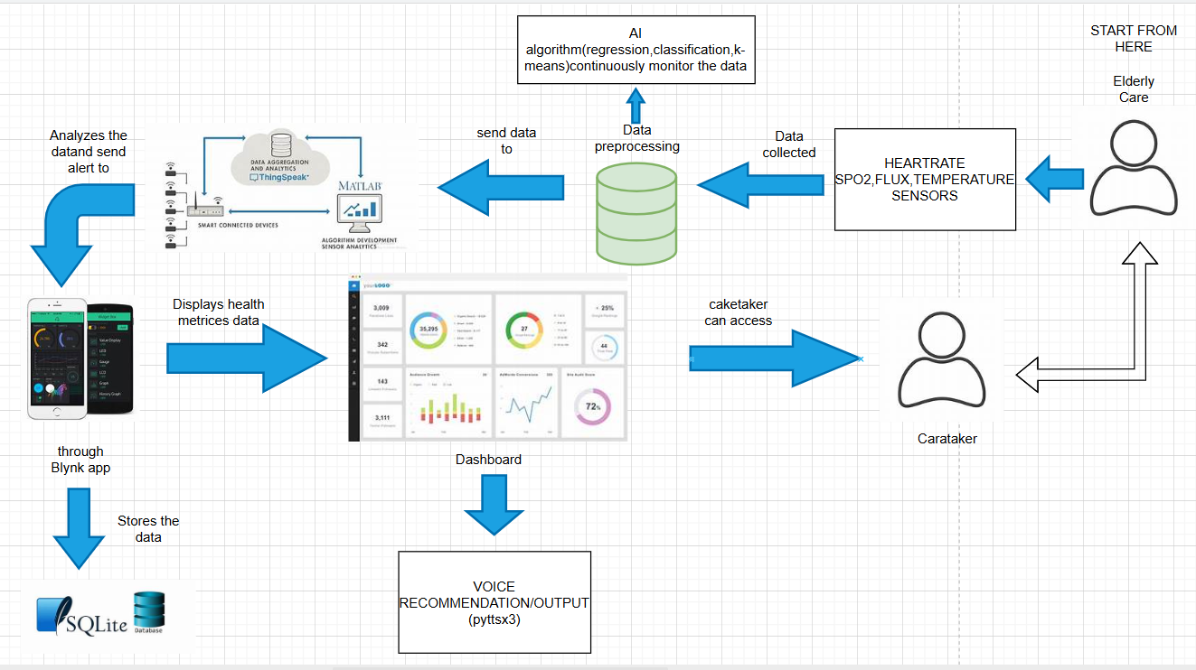
PROJECT ARCHITECTURE

Slide 14
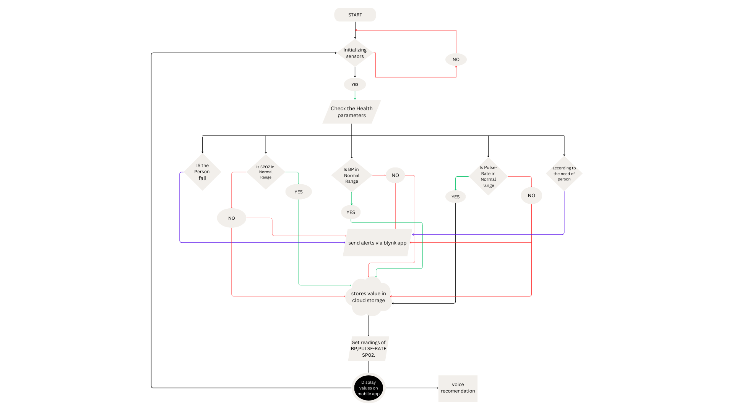
FLOW CHART

Slide 15
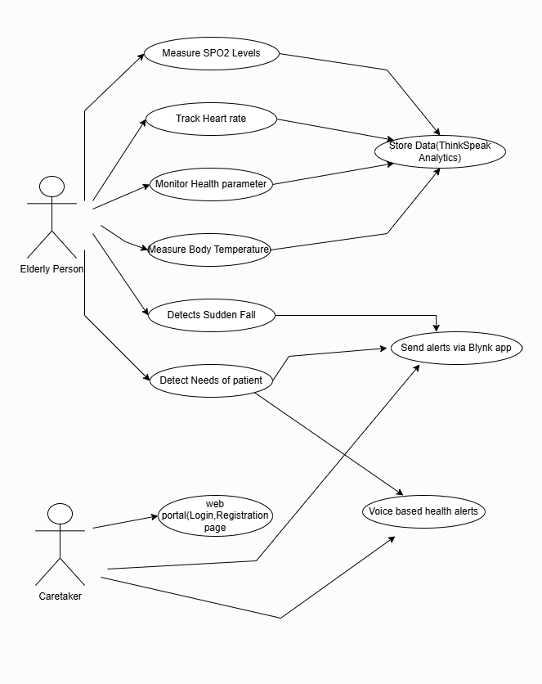
UML DIAGRAM USE CASE DIAGRAM

Slide 16
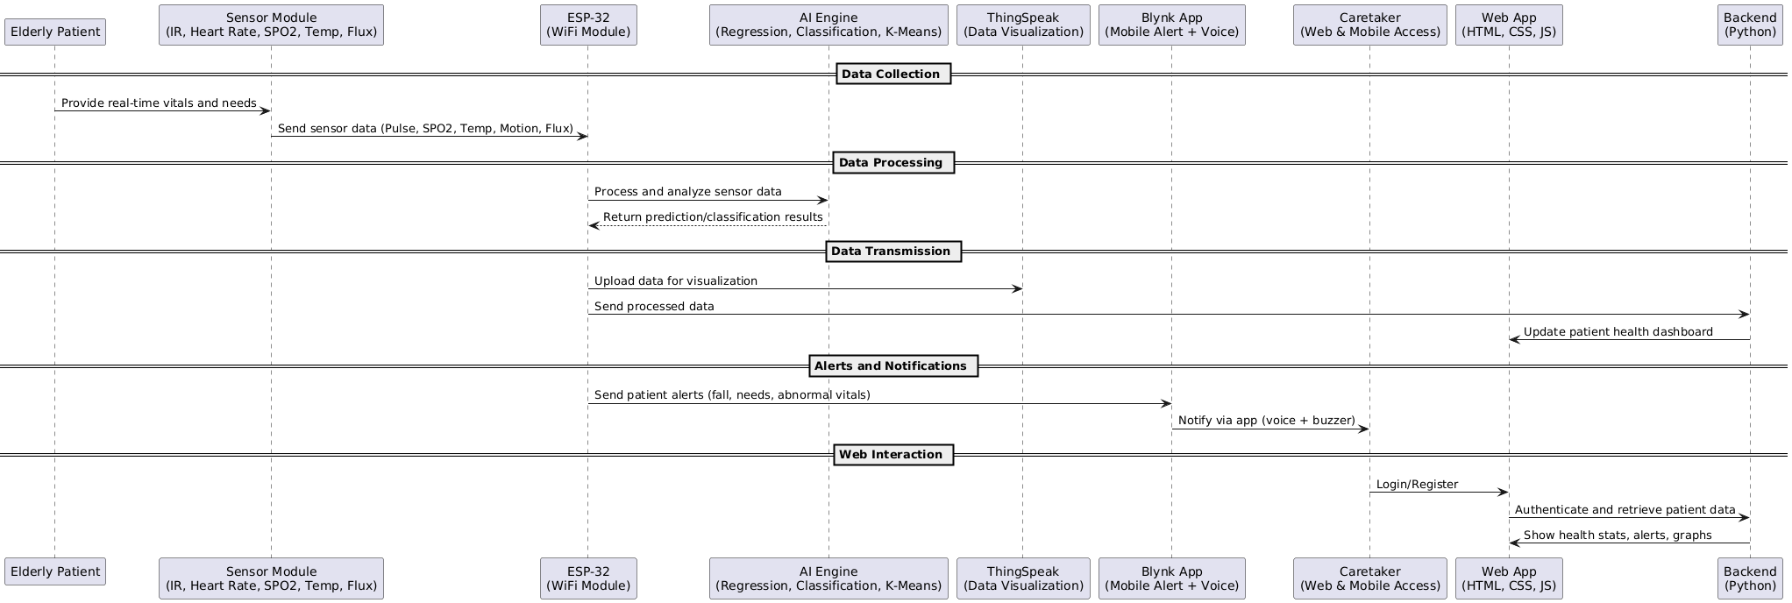
SEQUENCE DIAGRAM

Slide 17
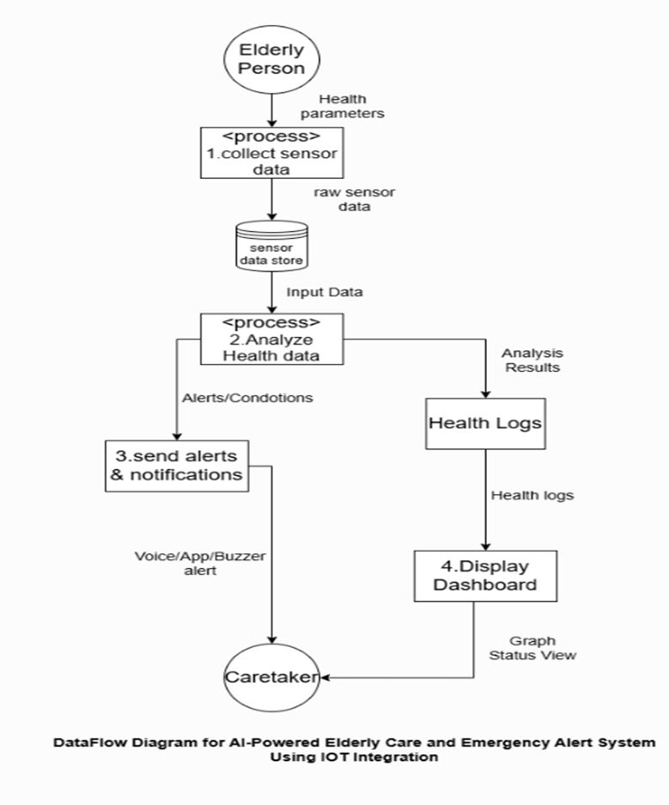
DATAFLOW DIAGRAM

Slide 18
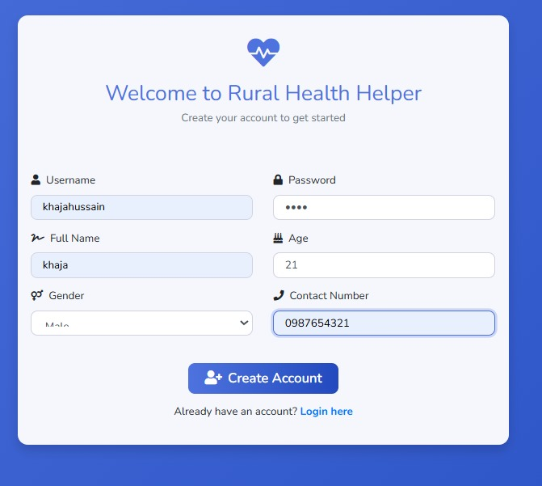
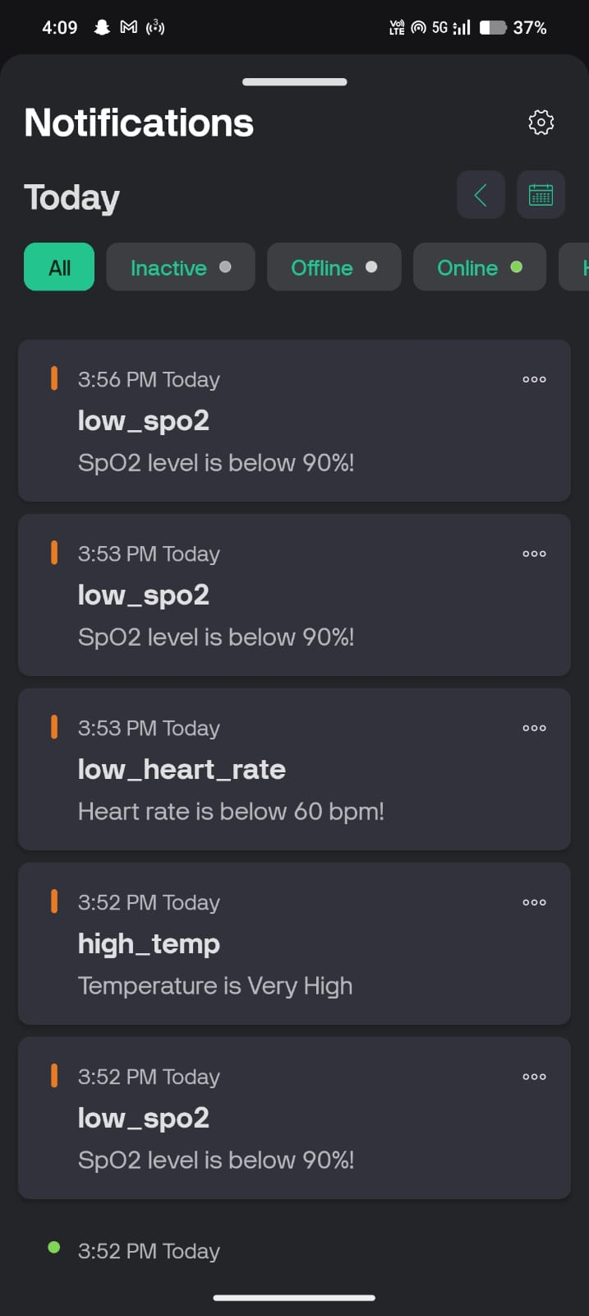
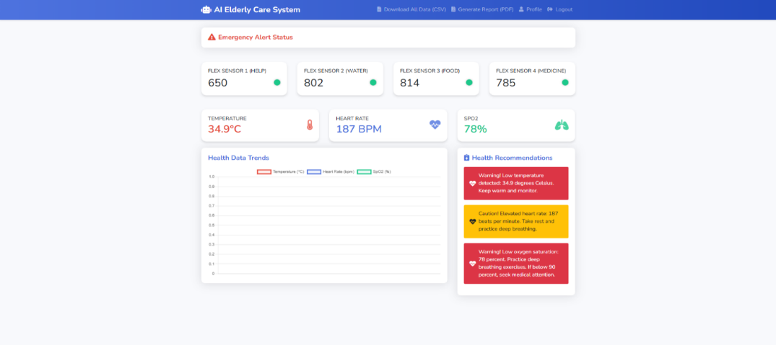
MODULES
1.User management:
By using Frontend technology in this project we create a web page such as Login page and Registration page by using(HTML,CSS, JAVASCRIPT).
If the patient is new clickon to registration page then fills the details of the patient if already registered login directly.
2. Emergency Alert:
The registered patient data stored in the cloud and the user can access data of the patient by login to the webpage.
Using THINKSPEAK platform the user can access the analyzed data which is collected from sensors that are integrated to WIFI Module(ESP-32).
According to analyzed and collected data an alert notifications sends to the caretakers using Blynk platform.
All these are done by using Backend technology in the project by (python).
3. Dashboard & Reporting:
We use an Voice recommendation in an AI-powered elderly care and emergency alert system using IoT integration, for caretakers to receive information about patient health conditions. Based on the data shown in thinkspeak.
According to health metrices data provides the health recommendation to caretakers to overcome the problem and provides the health metrices report of the patient.

Slide 19
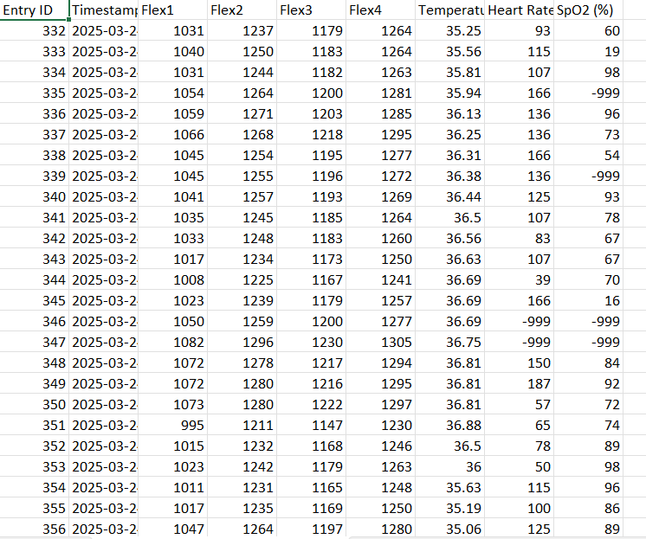
4.Health Monitoring:
The project uses various sensors, including IR Sensor that detects the motion of sudden fall of patient and alerts caretakers or family members, Heart rate sensor (pulse monitoring) that measures heart rate by detecting blood volume changes in arteries.
spo2 sensor that tracks blood oxygen saturation levels. Temperature Sensor that detects the body heat-rate of the elderly people.
All these sensors integrated to WIFI-module(ESP-32) which takes data from sensors and communicates with other components as per requirement.
Additionally, four flux sensors are used to notifies caretakers as per patient requirements(such as need water, food, medicine, Help etc.)
5. Voice Recommendation:
pyttsx3 is a Python module used for text-to-speech (TTS) conversion.
Unlike some other TTS libraries that require an internet connection, pyttsx3 works completely offline, making it a reliable choice for applications that need speech synthesis without external dependencies.
It is compatible with multiple operating systems, using Windows as its back-end speech engines.

Slide 20
SAMPLE CODE
from flask import Flask, request, jsonify, render_template, redirect, session, url_for, flash, send_file, make_response
import sqlite3
from flask_login import LoginManager, UserMixin, login_user, login_required, logout_user, current_user
from werkzeug.security import generate_password_hash, check_password_hash
from datetime import datetime
import csv
import io
import os
import requests
from reportlab.lib import colors
from reportlab.lib.pagesizes import letter
from reportlab.platypus import SimpleDocTemplate, Paragraph, Spacer, Table, TableStyle
from reportlab.lib.styles import getSampleStyleSheet, ParagraphStyle
from io import BytesIO
import time

Slide 21
import pyttsx3
from threading import Thread
THINGSPEAK_CHANNEL_ID = "2888039“
THINGSPEAK_READ_API_URL =
f"https://api.thingspeak.com/channels/{THINGSPEAK_CHANNEL_ID}/feeds.json"
app = Flask(__name__)
app.secret_key = 'your_secret_key_here'
# Initialize the database
conn = sqlite3.connect('health_data.db', check_same_thread=False)
cursor = conn.cursor()
# Create tables
cursor.execute('''CREATE TABLE IF NOT EXISTS users (
id INTEGER PRIMARY KEY AUTOINCREMENT,
username TEXT UNIQUE,
password TEXT,
name TEXT,
age INTEGER,
gender TEXT,
contact TEXT
)''')

Slide 22

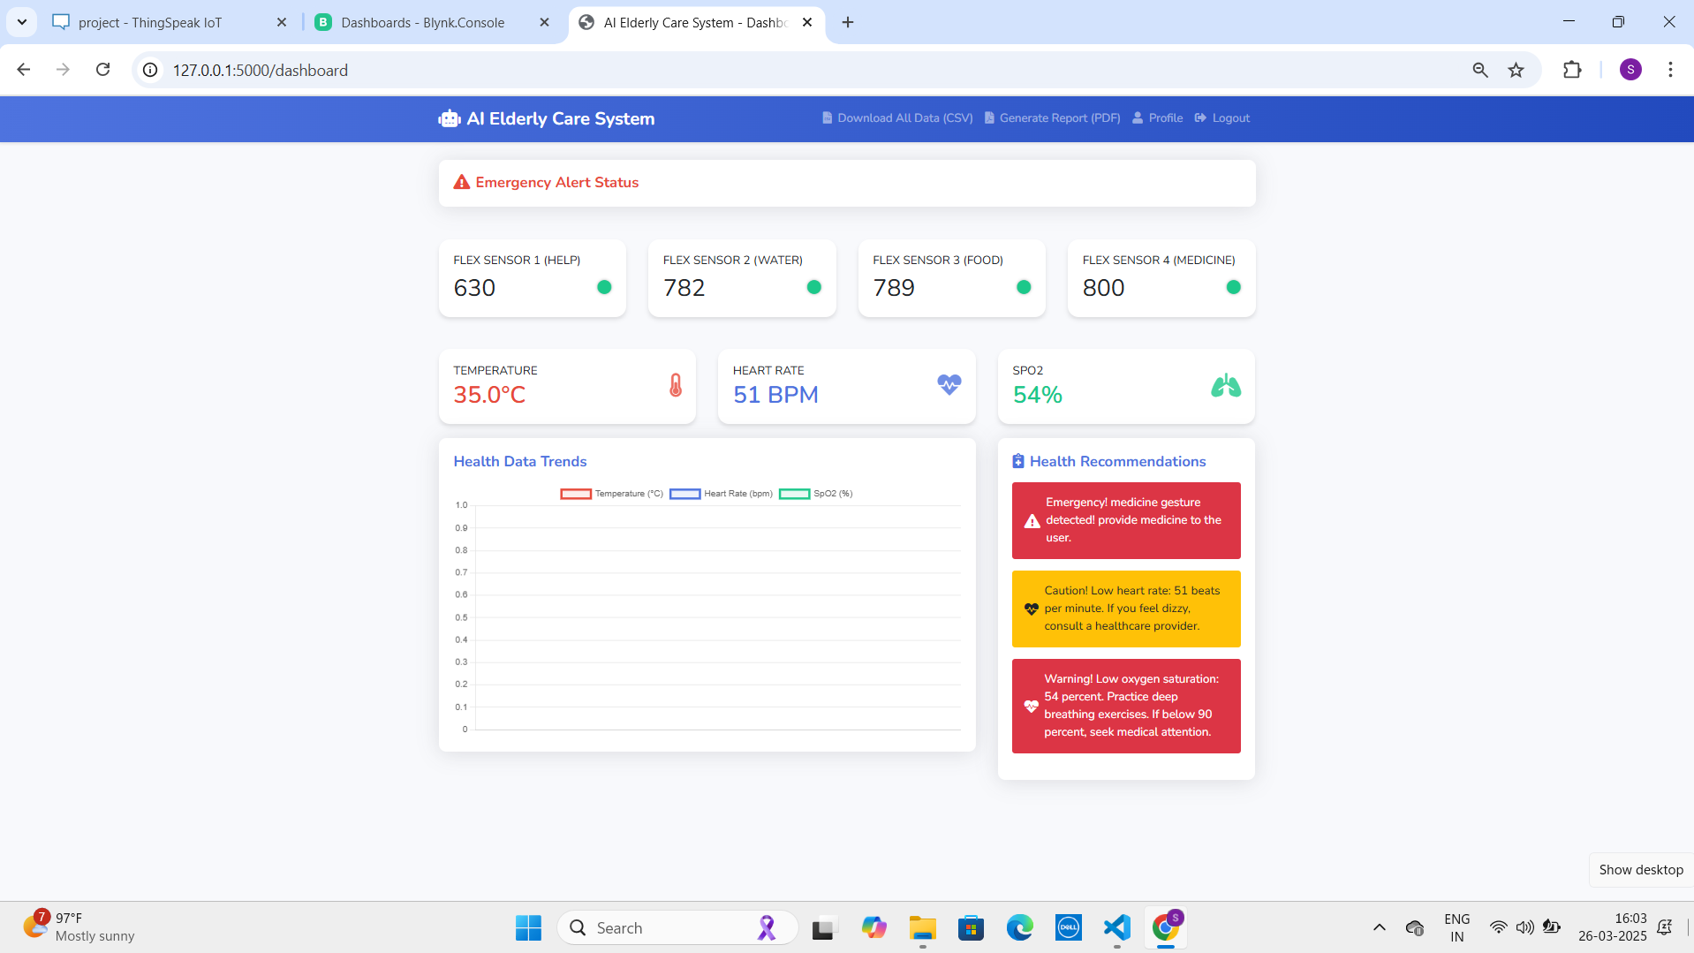
RESULTS
Indicates the health metrices data of a patient in a dashboard with an alert system.
Indicates the alert according to patient’s requirements and with an recommendation.

Slide 23
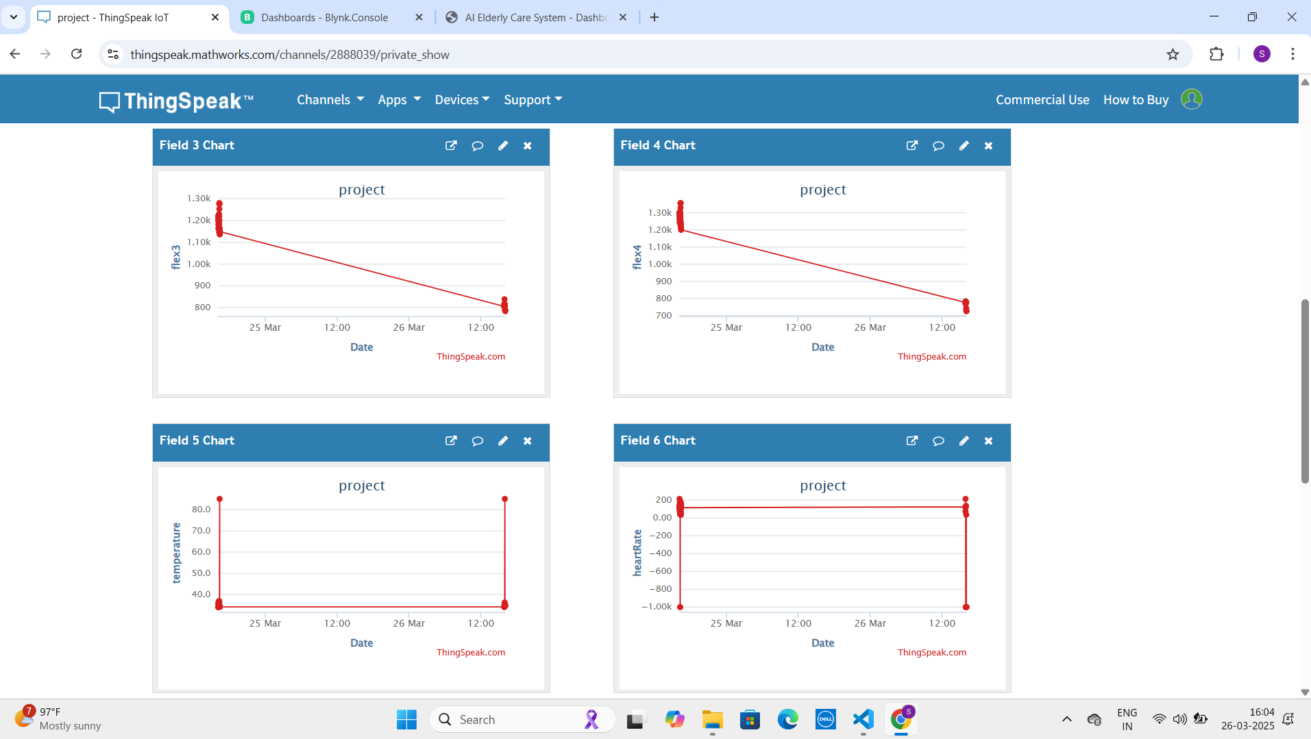

Indicate the patient’s data in graphical form through Thinkspeak platform.
Indicates the alerts of health metrices data of patient through blynk platform

Slide 24
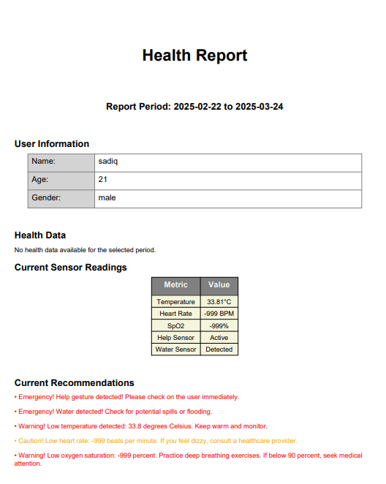
Indicates continuous health monitoring data of patient
Indicates the report of the patient based on the time period

Slide 25
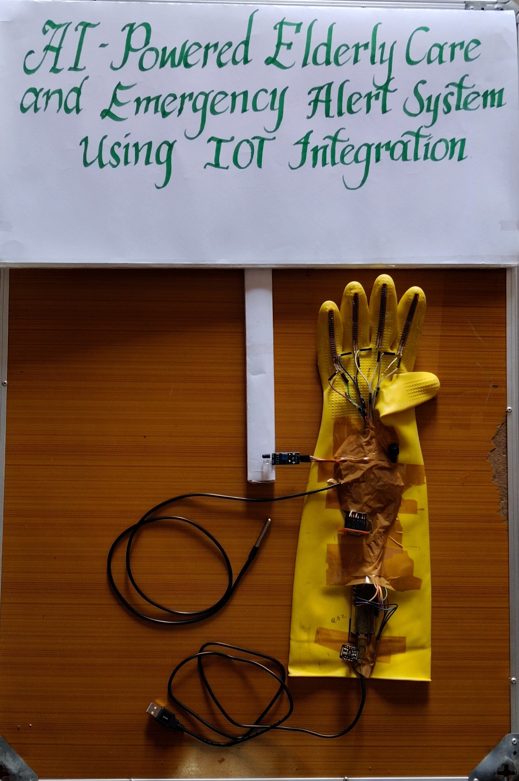
MODEL REPRESENTATION OF OUR PROJECT

Slide 26
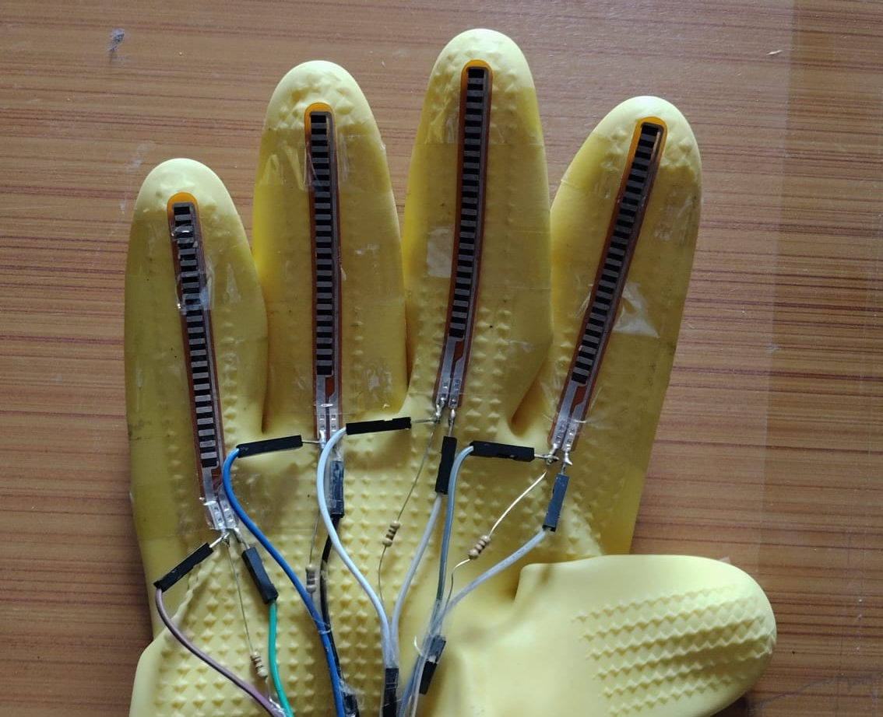
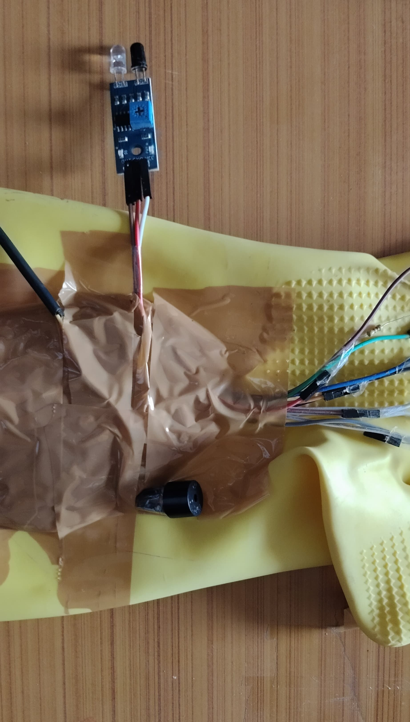
REPRESENTATION OF 4 FLUX SENSORS
REPRESENTATION OF IR SENSOR AND BUZZER

Slide 27
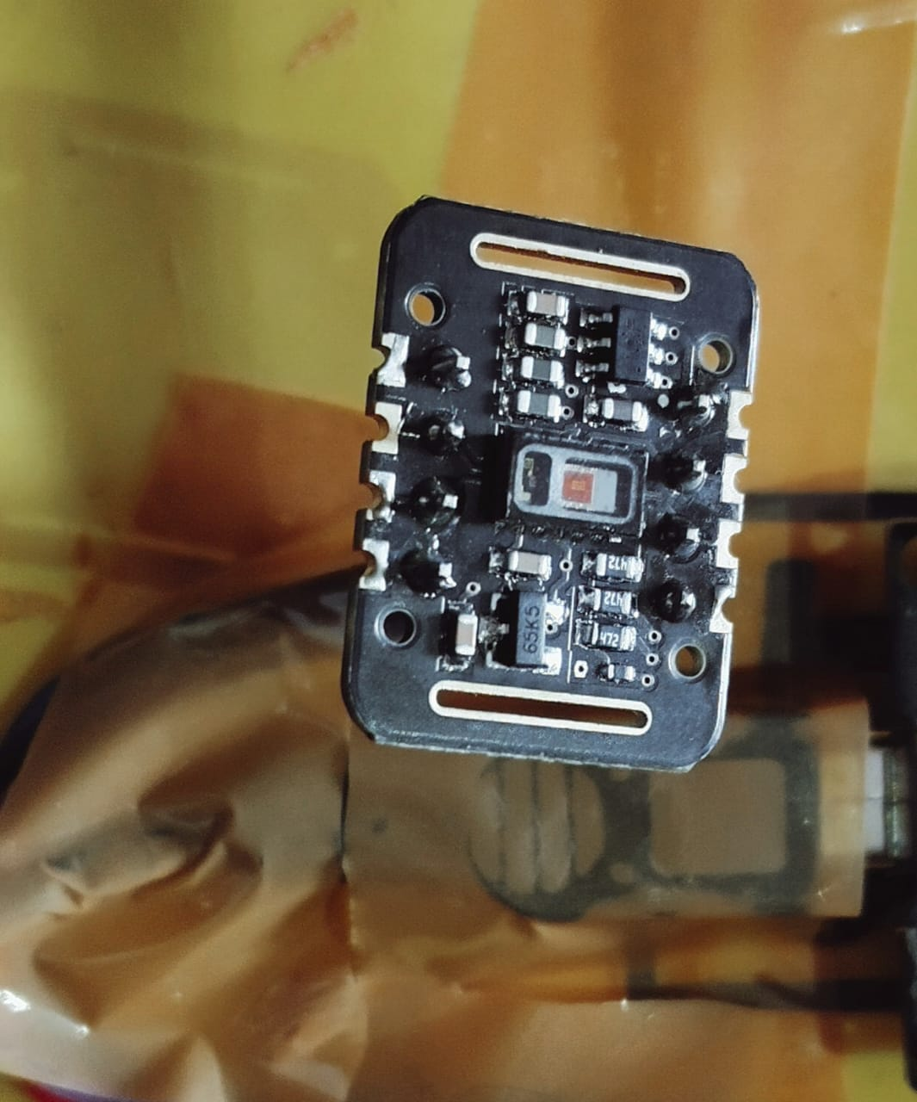
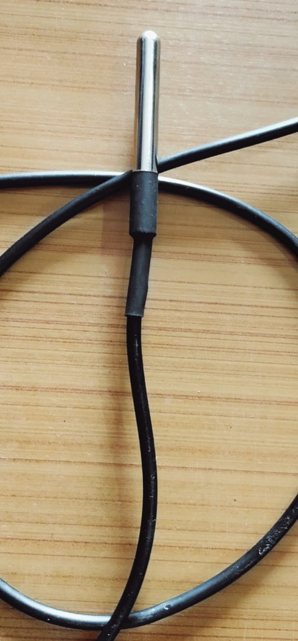
REPRESENTATION OF HEART RATE AND SPO2 SENSOR
REPRESENTATION OF TEMPERATURE SENSOR

Slide 28
FUTURE SCOPE
Faster Real-time alerts with 5G Technology:
The implementation of 5G technology will significantly enhance the system’s real-time responsiveness. With ultra-fast data transmission, alerts from sensors to cloud servers to caregivers will be almost instantaneous.
AI –Powered Robotic Assistance for Elderly Care:
The system can be further extended with AI-powered robots that assist elderly individuals in their daily routines. These robots can help with medication reminders, mobility support, household tasks, and even provide companionship.
Improved Security with Block chain based Data Encryption:
To enhance data security and privacy, future versions of the system can integrate blockchain technology. This will ensure that patient health records remain secure, tamper-proof, and accessible only to authorized individuals.
Telemedicine and remote Healthcare services:
Integrating the system with telemedicine platforms will allow elderly patients to consult doctors remotely.This will reduce hospital visits and provide convenient healthcare access to elderly individuals, especially those in rural areas.

Slide 29
CONCLUSION
The AI-powered elderly care and emergency alert system using IoT integration is a revolutionary solution aimed at enhancing the safety and well-being of elderly individuals.
By integrating advanced sensors, AI-driven analytics, cloud storage, and real-time emergency alert mechanisms, the system ensures continuous health monitoring and immediate response to critical situations.
The use of IoT and AI technologies allows for accurate data collection, intelligent health recommendations, and seamless communication between patients, caregivers.
Through rigorous testing, including integration, performance, security, and usability testing, the system has been optimized for real-time responsiveness, reliability, and user-friendly interaction.
It effectively detects abnormal health conditions such as irregular heart rate, sudden falls, and instantly notifies caregivers, reducing emergency response time.
The incorporation of cloud-based storage ensures that patient health data is securely stored and easily accessible, while AI algorithms like k-means,regression etc help in predicting potential health risks.
Overall, this project addresses critical healthcare challenges faced by elderly individuals, offering an innovative and automated approach to elderly care.
It provides a cost-effective, efficient, and scalable solution for home-based healthcare, ensuring timely medical intervention and improved quality of life for senior citizens.

Slide 30
REFERENCES
Mittal, S. (2023). AI-powered elderly care system [GitHub repository]. GitHub. https://github.com/shivammittal09/AI-Powered-Elderly-Care-System
ScienceDirect. (2022). AI-based elderly fall prediction system using wearable sensors: A smart approach. ScienceDirect. https://www.sciencedirect.com/science/article/pii/S2665917422002483
Sidtheboss. (2023). AI-powered fall detection system using IoT and machine learning [GitHub repository]. GitHub. https://github.com/Sidtheboss/Elderly-People-fall-detection
MDPI. (2022). A survey of IoT-based fall detection for aiding elderly care. MDPI Applied Sciences, 12(7), 3276. https://www.mdpi.com/2076-3417/12/7/3276
IEEE Smart Cities. (2023). An automated wearable fall detection system for elderly people. IEEE. https://smartcities.ieee.org/newsletter/august-2023/an-automated-wearable-fall-detection-system-for-elderly-people
Frontiers in Artificial Intelligence. (2025). Integrating generative adversarial networks with IoT for adaptive AI in elderly care. Frontiers. https://www.frontiersin.org/journals/artificial-intelligence/articles/10.3389/frai.2025.1520592/full

Slide 31
THANK YOU

